Slide 1
Monthly Calendar

Slide 2
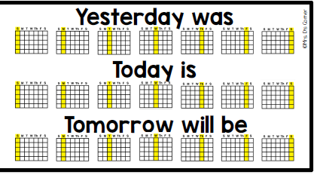

Slide 3
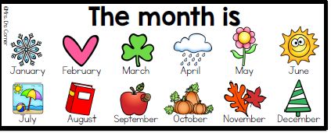

Slide 4
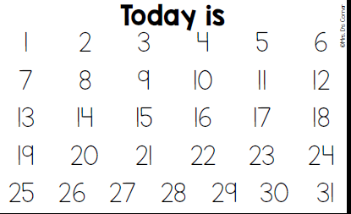

Slide 5
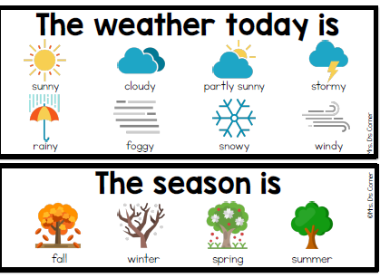

Slide 6
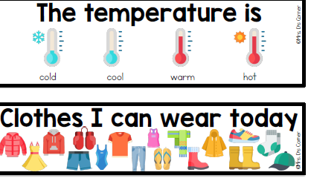

Slide 9
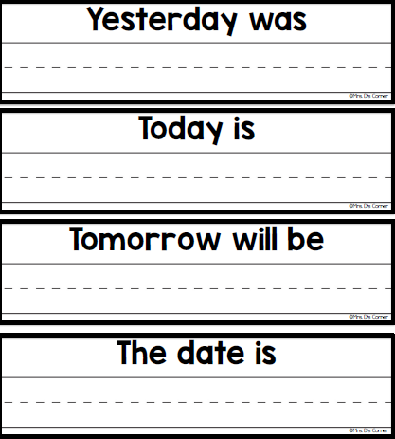

Slide 10
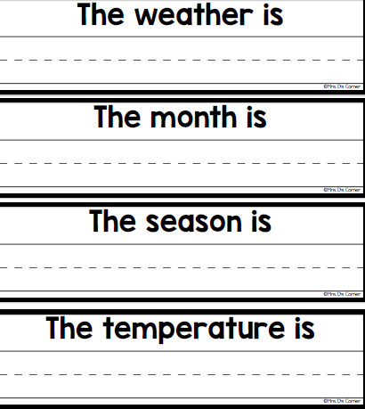

Slide 11
Songs of the Day:
Monday: Happier-Kids Bop- https://www.youtube.com/watch?v=JaK0Vrkzu80
Tuesday: Taco Tuesday- https://www.youtube.com/watch?v=94gG8JLKy74
Wednesday: State Song- https://www.youtube.com/watch?v=_E2CNZIlVIg
Thursday: Fox Song- https://www.youtube.com/watch?v=jofNR_WkoCE
Friday: Happy- https://www.youtube.com/watch?v=ZbZSe6N_BXs

